Slide 1
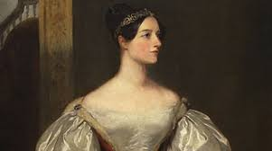

Augusta
Ada
Lovelace
2018_05_11
Gabriela Teles

Slide 2
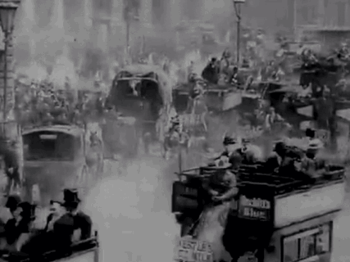
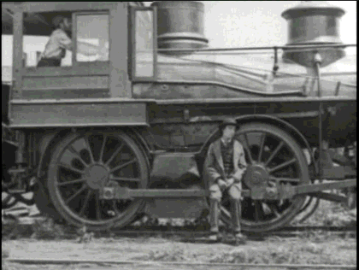
Georgian Era and Industrial Revolution
(1714 – 1837)
Navigation...
Trade...Orient Tea
Inports to Orient...
Demographics – citie grow and migrations.
Polution...
After...
Before...

Slide 3
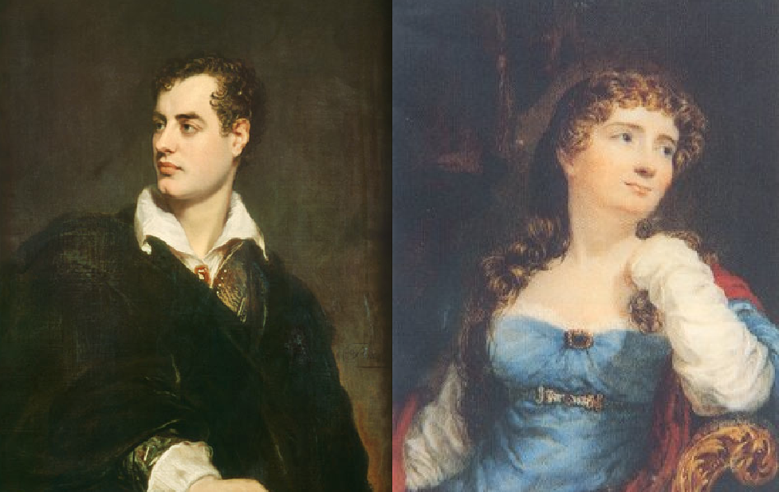
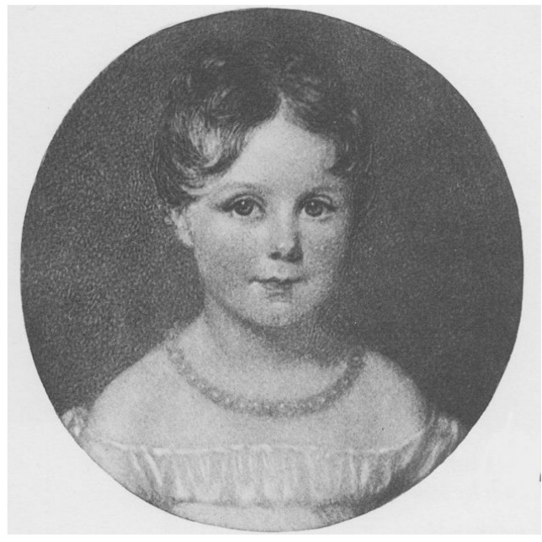
Romanticism
(1800 - 1850)
George Gordon Byron,
Lord Byron
(1788 – 1824)
Anne Isabella Milbanke,
Lady Wentworth
(1792 – 1860)
Augusta Ada Byron
10 Dec. 1815

Slide 4
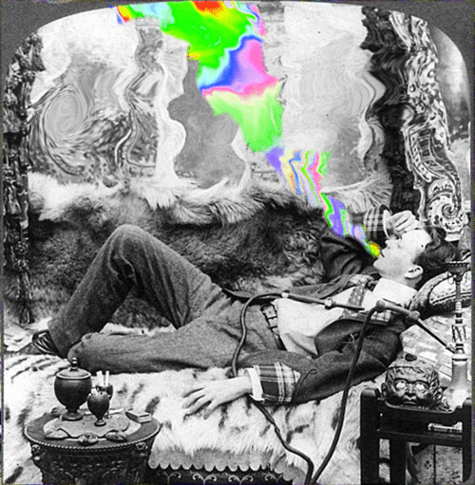
Emotion and individualism.
Glorification of the past and nature
Medieval versus classical.
Orientalism and the Gothic novel.
Augusta Maria Leigh & Byron.
Divorce.
«The great art of life is sensation, to feel that we exist, even in pain.» - Lord Byron
Lord Byron

Slide 5
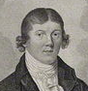
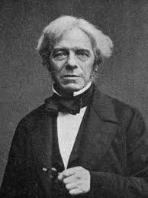
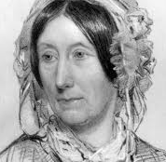
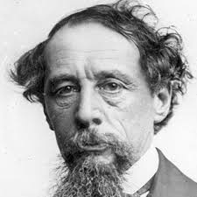
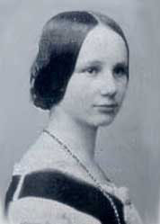
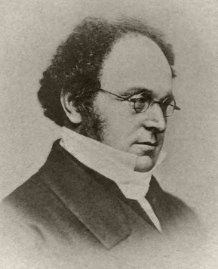
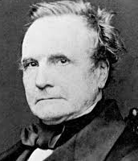
Education
Victorian Era
(1837 – 1900)
Friends
Marriage
William Frend
1757 -1841
William King-Noel,
1st Earl of Lovelace
Louis Farady
1791 -1867
Mary Sommerville
1780 -1872
Charles Dickens
1812 -1870
Countess of Lovelace
1835
Augustus de Morgan
1806 -1871
Charles Babbage
1791 - 1871

Slide 6
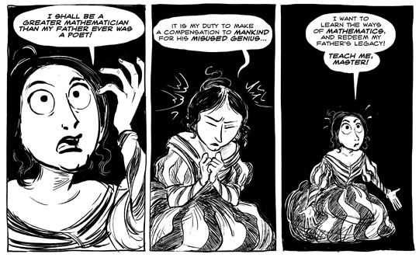

Slide 7
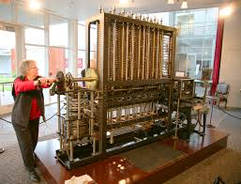
«The purpose which that engine has been specially intended and adapted to fulfil, is the computation of nautical and astronomical tables(…)», in Note A
The “Computers”…
Tables for everything… Sailing into death…
1826, Babbage invented something he called Mechanical Notation.
He figured out how to control the steps in a computation using punched cards of the kind that had been invented in 1801 by Jacquard.
The Difference Engine prototype
“I wish to God these tables had been made by steam!”, in 1819

Slide 8
The Jacquard Loom of patterned perfurated cards

Slide 9
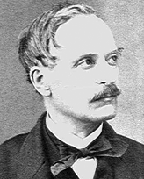
Luigi Menabrea’s French paper (1842) is translated to English by Ada Lovelace: a Sketch of the Analytical Engine Invented by Charles Babbage.
1809 -1896
«The Analytical Engine is an embodying of the science of operations, constructed with peculiar reference to abstract number as the subject of those operations. The Difference Engine is the embodying of one particular and very limited set of operations(…)», in Note A
«The operating mechanism can even be thrown into action independently of any object to operate upon(…) Supposing, for instance, that the fundamental relations of pitched sounds in the science of harmony and of musical composition were susceptible of such expression and adaptations, the engine might compose elaborate and scientific pieces of music of any degree of complexity or extent. », in Note A

Slide 10
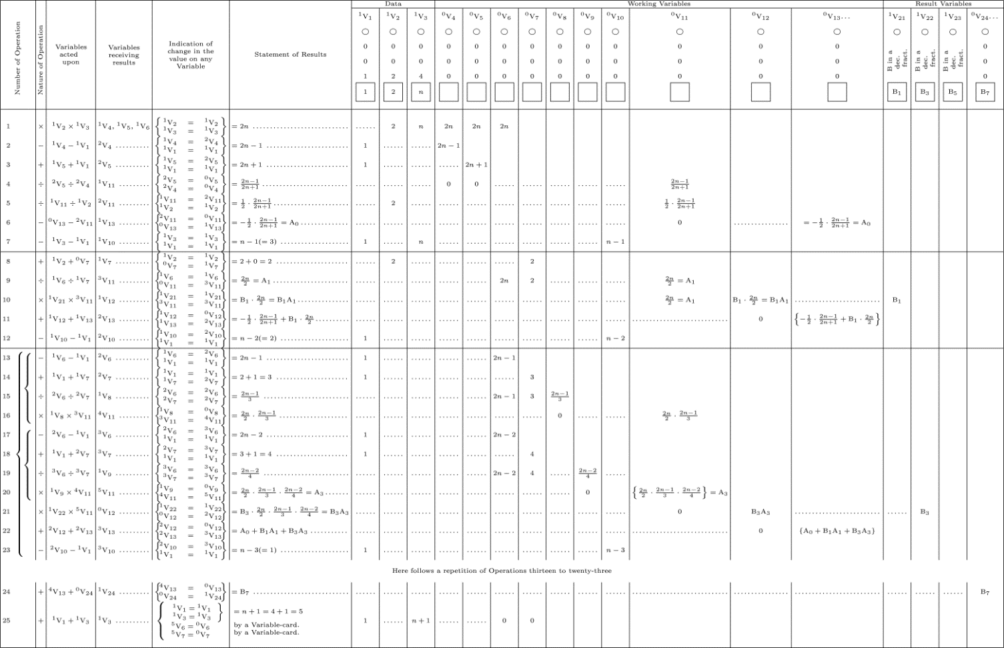
It is a program that runs for 25 steps (plus a loop) on the Analytical Engine. At each step, the trace shows what operation is performed on which Variable Cards, and which Variable Cards receive the results.
Diagram for the computation of Bernoulli numbers, in Note G

Slide 11
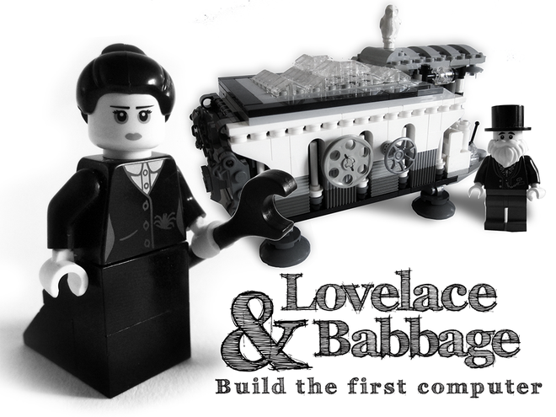
Charles Babbage was the first to build a mechanical computer, the Difference Engine.
“The Analytical Engine has no pretensions whatever to originate anything. It can do whatever we know how to order it to perform…. Its province is to assist us in making available what we are already acquainted with.” - A.A.L.
Ada Lovelace was the first programmer and person ever to glimpse with any clarity the notion of universal computation; She was determined to build it ...

Slide 12
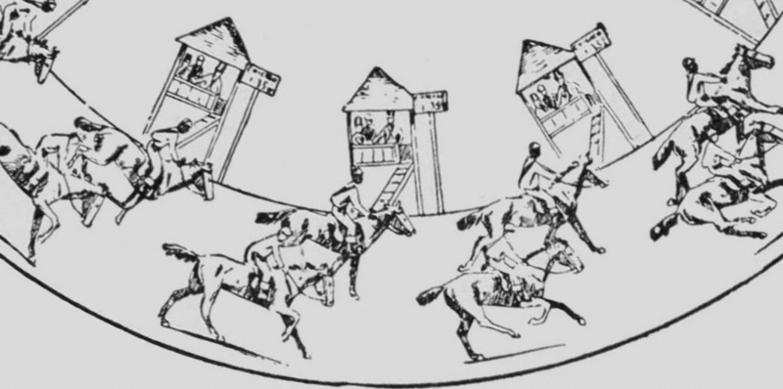
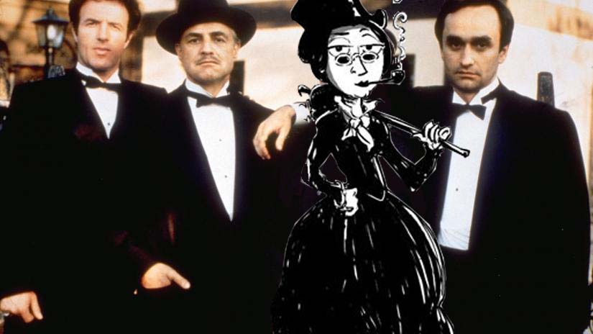
The ‘Gamblesters’ Sindicate…

Slide 13
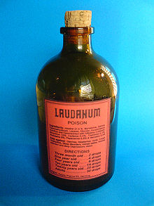
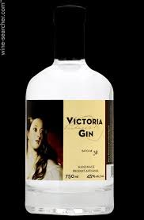
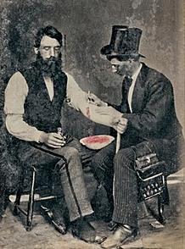
Well! You do the Math...
...there’s only one result...

Slide 14
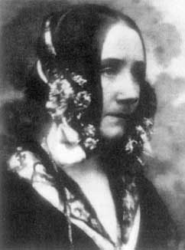
Ada dies with 36 years...
The visionary of programming rested near her father...until Alan Turing rediscover her and Babbage’s work, in 1940.

Slide 15
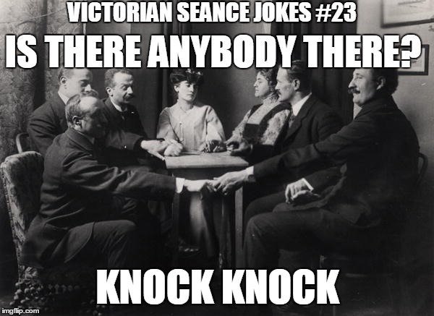

Slide 16
A SKETCH OF THE ANALYTICAL ENGINE INVENTED BY CHARLES BABBAGE, by L.F. Menabrea. With notes upon the Memoir by the translator Ada Augusta, countess of Lovelace http://www.fourmilab.ch/babbage/sketch.html#menaref1
UNTANGLING THE TALE OF ADA LOVELACE, by Stephen wolfran
http://blog.stephenwolfram.com/2015/12/untangling-the-tale-of-ada-lovelace/
WIKIPEDIA
THE THRILLING ADVENTURES OF LOVELACE AND BABBAGE by Sydney Padua – Comic Book
BBC DOCUMENTARY : Calculating Ada - The Countess of Computing 2015 https://www.youtube.com/watch?v=QgUVrzkQgds

